Slide 1
DWDM PROJECT (data mining on recommendation system)
PRESENTED BY:
NIDHI BHARDWAJ(00701032014)
AISHWARYA GUPTA(01901032014)
ANAMIKA KATYAL(039010302014)

Slide 2
Overview
Background
Objective
Methodology
Results
Demonstration

Slide 3
Background
Social media platforms are increasingly popular and widely used.
It is a platform where people share their thoughts and emotions.
Online Social Media Platform used : Twitter

Slide 4
Background cont.…
Why we need this type of recommender system
People share their concerns and feelings on social media
By analysis of their Online Social Activities an NGO can connect with right set of people
We are providing a platform where a NGO can find and connect with volunteers

Slide 5

Objective
Propose a metric that quantifies user interest.
Mapping user interests with topic(the field in which NGO work).
Apply data-mining techniques to find suitable algorithm and use machine leaning .
Develop a framework to enable NGOs connect to OSM users.

Slide 6
Methodology
Data Collection
Data Cleaning
Analysis
Results

Slide 7

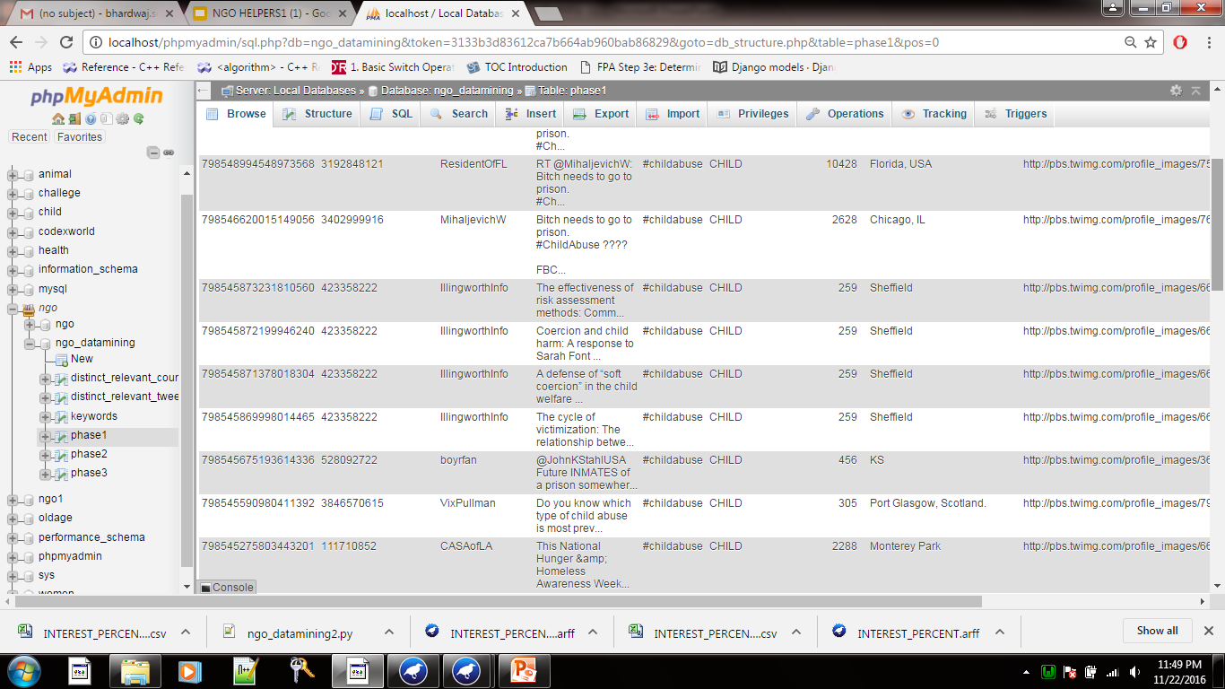
Methodology Cont..
Data Collection
Identify Keywords Expressing interests(eg: women welfare, child labor, help, care, animal, old age etc.)
Data collected using Tweeter API
Extract pertinent information from the data

Slide 8
Methodology Cont..
Data Collection
Data Cleaning
Analysis
Results

Slide 9

Methodology Cont..
Data Cleaning
Cleaning user data using new set of keywords defined category wise.
5 broad categories are: Child Welfare, Animal Welfare, Women Welfare, Old Age & Health Care

Slide 10
Methodology Cont..
Data Collection
Data Cleaning
Analysis
Results

Slide 11

Methodology Cont..
Analysis
Extracted relevant tweets from user timeline
Calculated Interest Index of each user
If it crosses previously defined Minimum Interest Index(MII)
Classify user as Relevant user else Irrelevant user

Slide 12
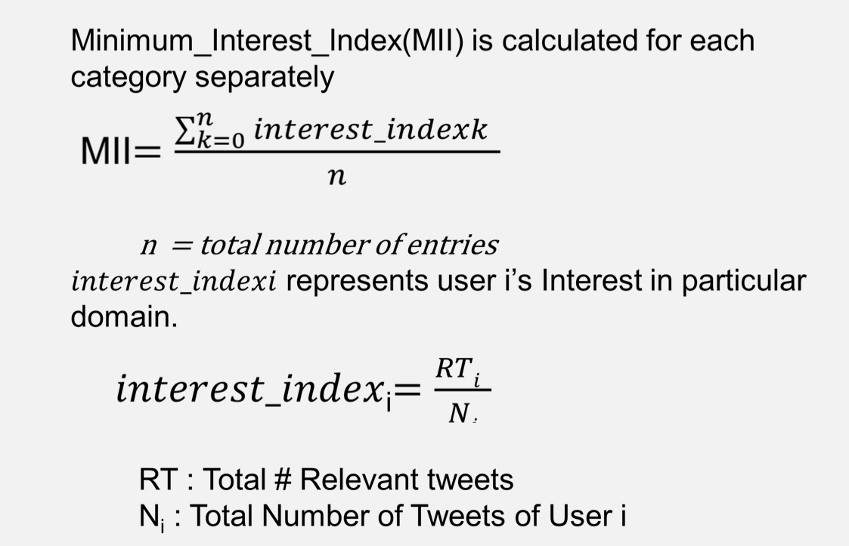
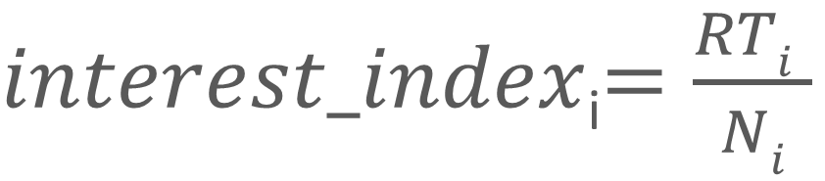
Methodology Cont..
Analysis(2)
$interest_index$_{i}$=\frac{RTi }{Ni}$

Slide 13
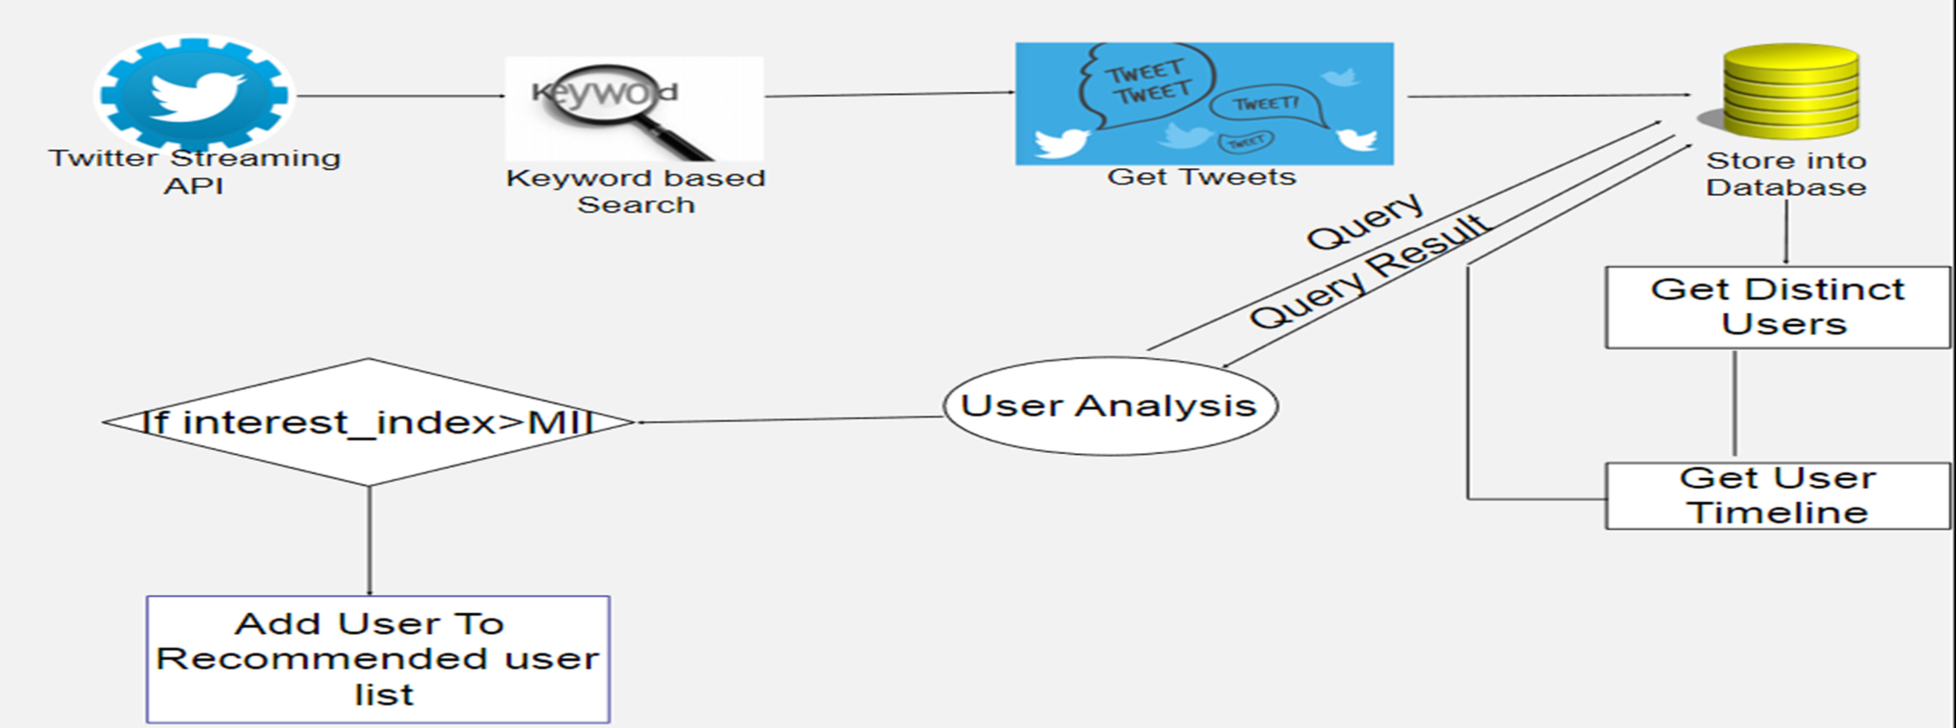
Methodology Cont.…
Control Flow Diagram

Slide 14
Algorithms used for analysis
Naive Bayes classification algorithm
logistic classifier
J-48 algorithm
Decision table
Simple k-means

Slide 15
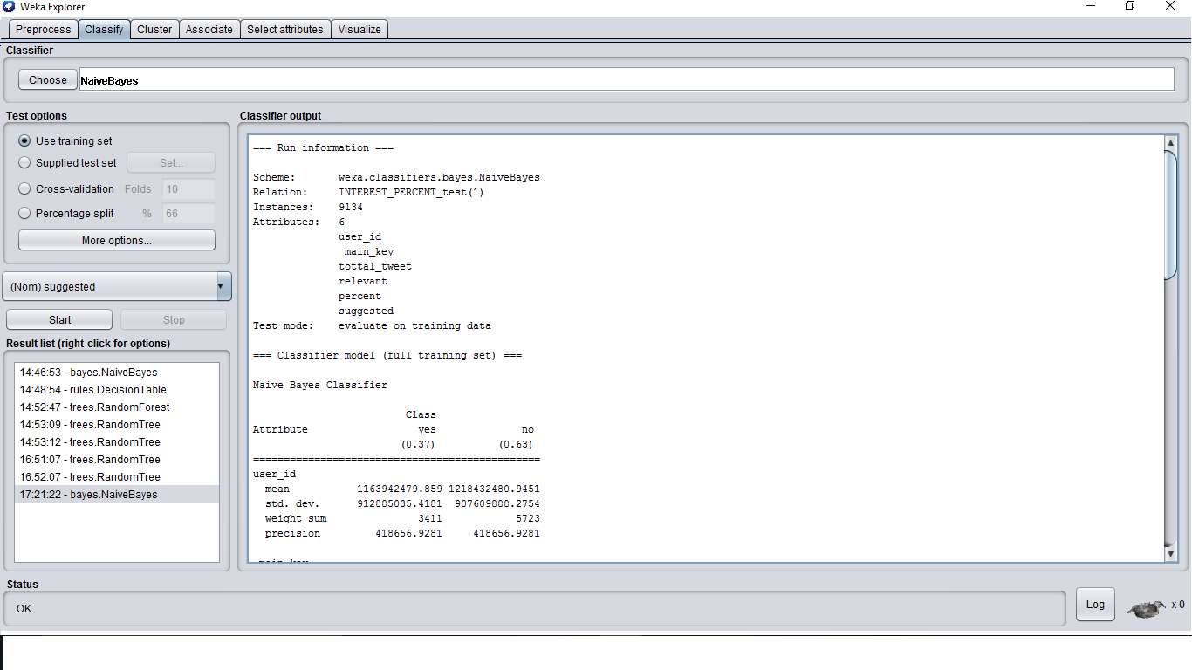
NAÏVE Bayes algorithm implementation on weka

Slide 16
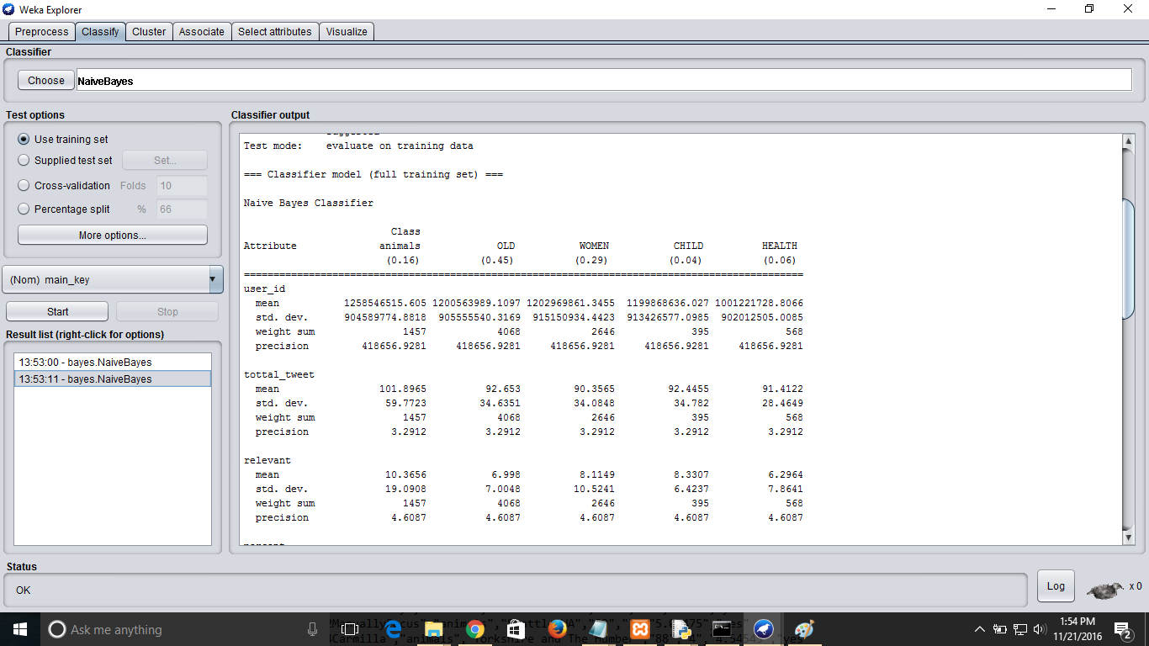

Slide 17
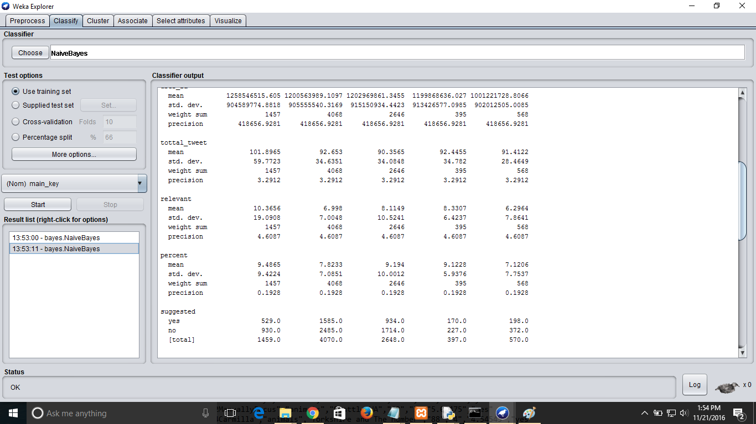

Slide 18
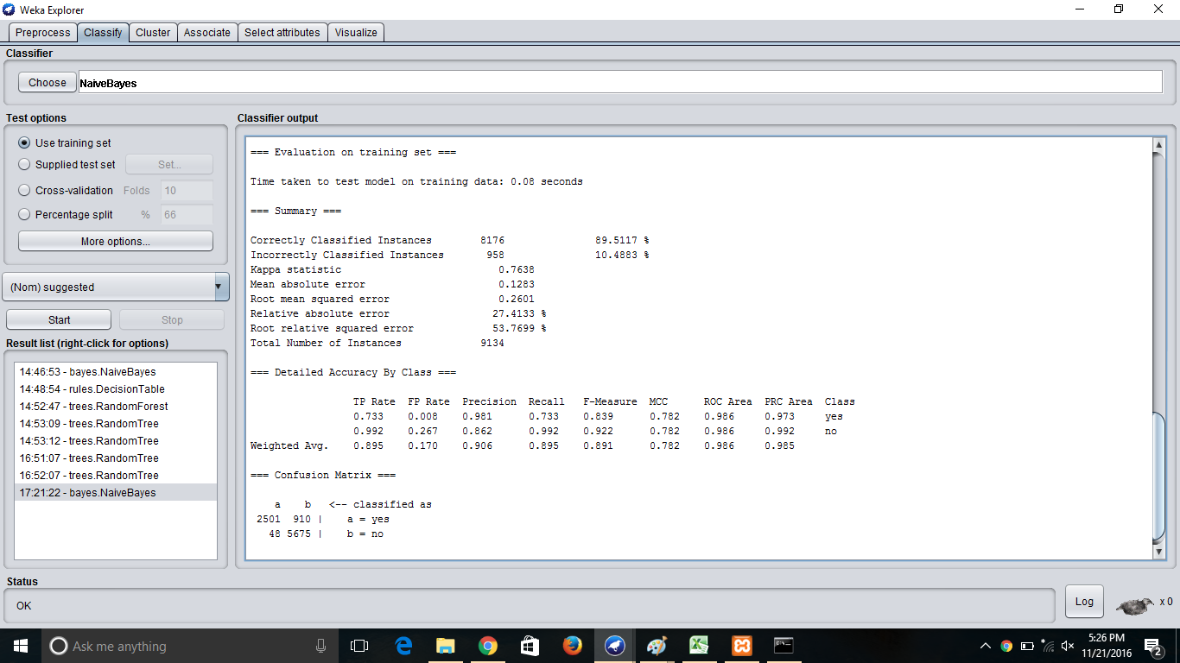

Slide 19
result from naïve Bayes classification
Total Instances=9134, Classification based on class label=YES/NO, whether a person can be suggested to an NGO of a particular category.
Correctly classified instances=8176 ,89.5117%
Incorrectly classified instances=958 ,10.4883%
Mean absolute error=0.1283
Root Mean Squared error=0.2601
=== Confusion Matrix ===
a b <-- classified as
2501 910 | a = yes
48 5675 | b = no

Slide 20
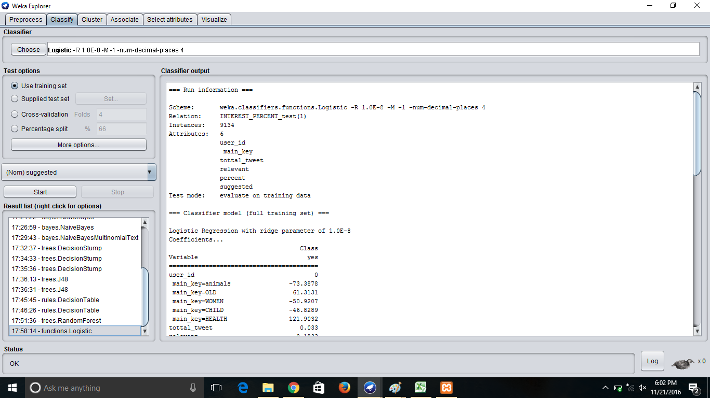
LOGISTIC CLASSIFIER

Slide 21
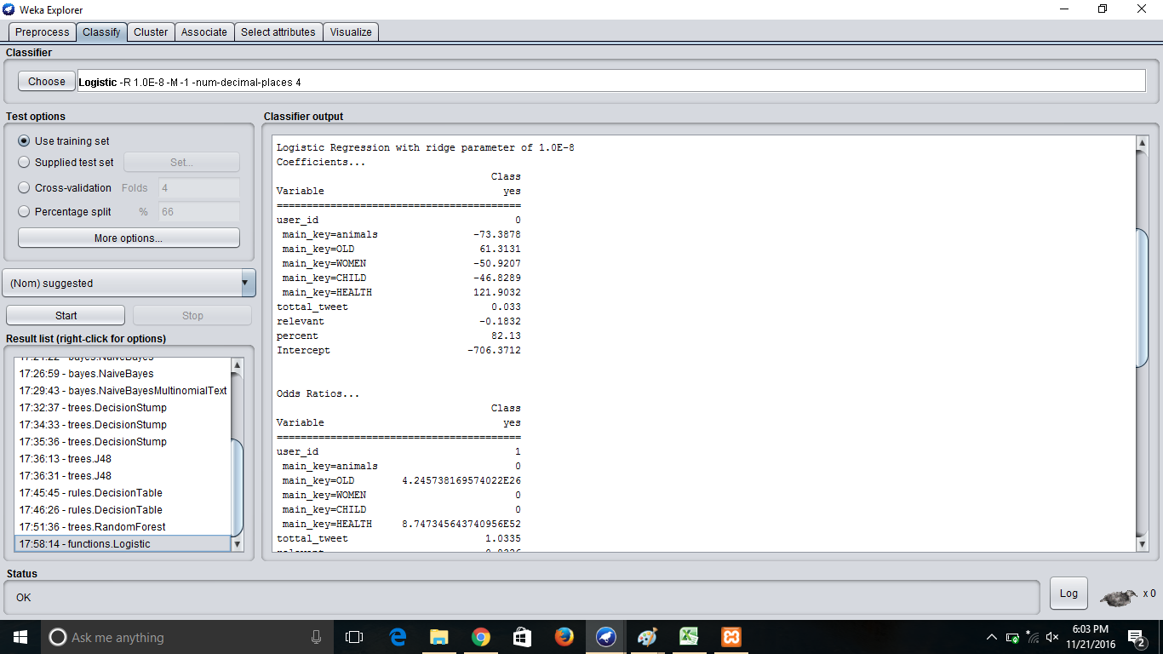

Slide 22
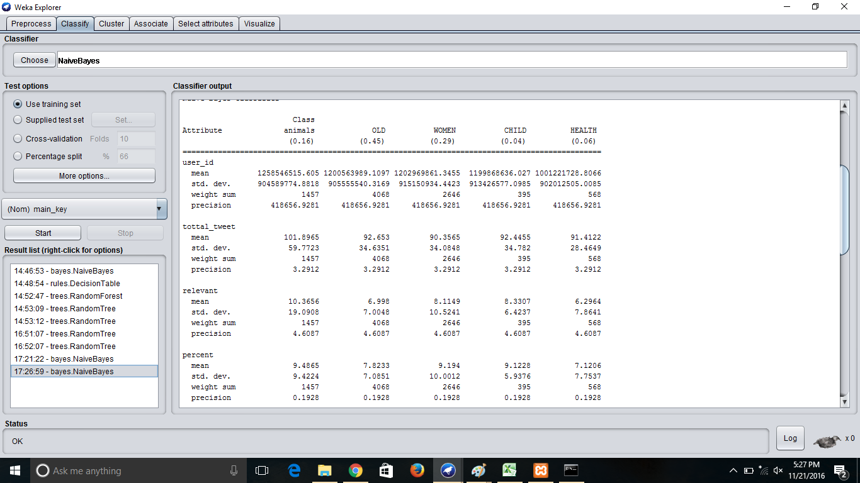

Slide 23
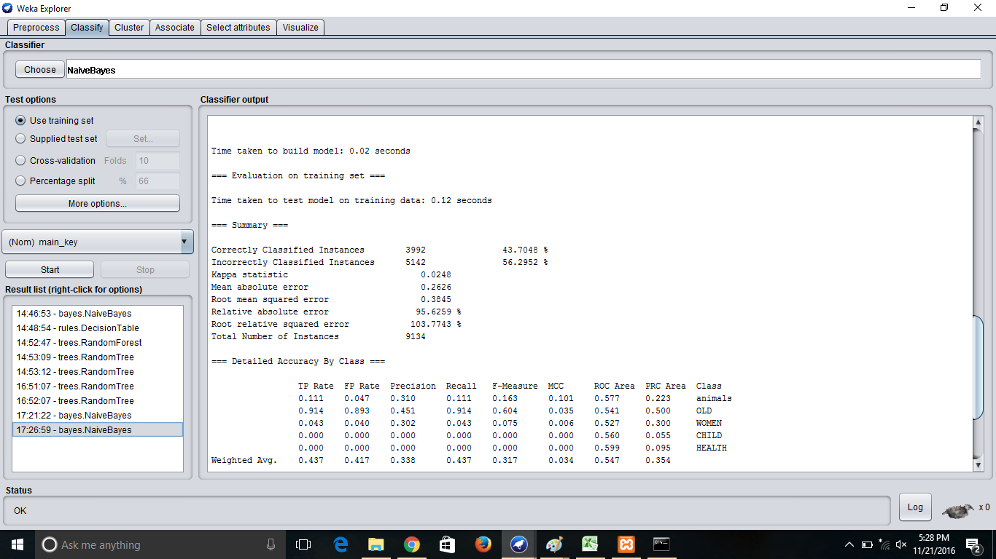

Slide 24
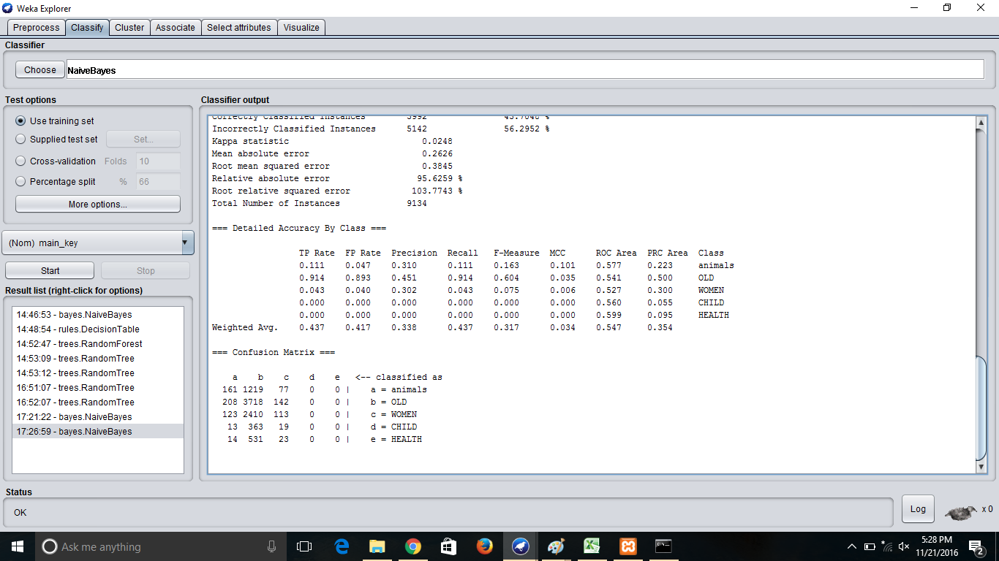

Slide 25
RESULT OF LOGISTIC CLASSIFICATION
Total Instances=9135
Correctly Classified Instances=9132 i.e.=99.9781%
Incorrectly Classified Instances=2 i.e.=0.0219%
Mean absolute error= 0.0008
Root Mean Squared error= 0.0157

Slide 26
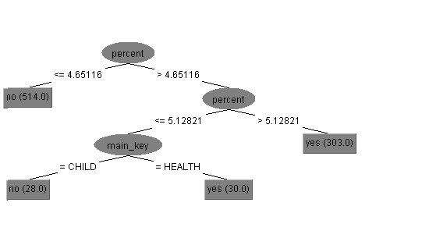
J-48 ALGORITHM
J-48 ALGORITHM implemented for the class label suggested =YES/NO
SUGGESTED class label is analyzed for the categories CHILD & HEALTH

Slide 27
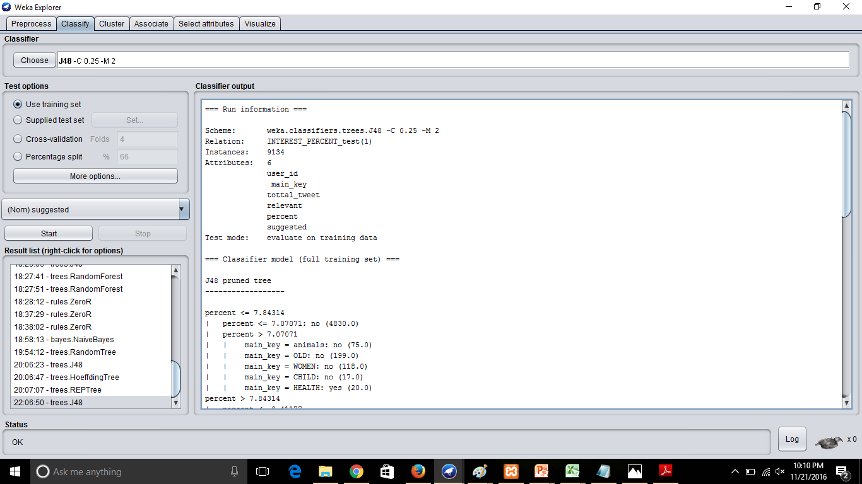
j-48 on class label suggested=YES/NO

Slide 28
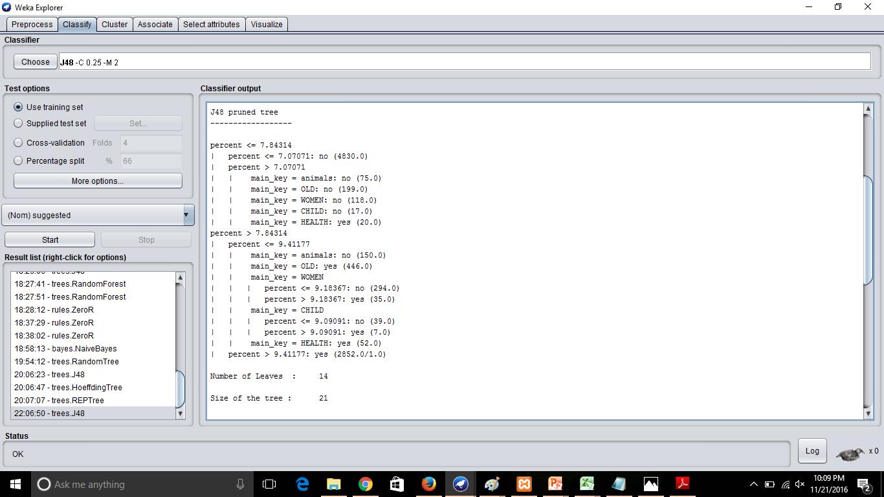

Slide 29
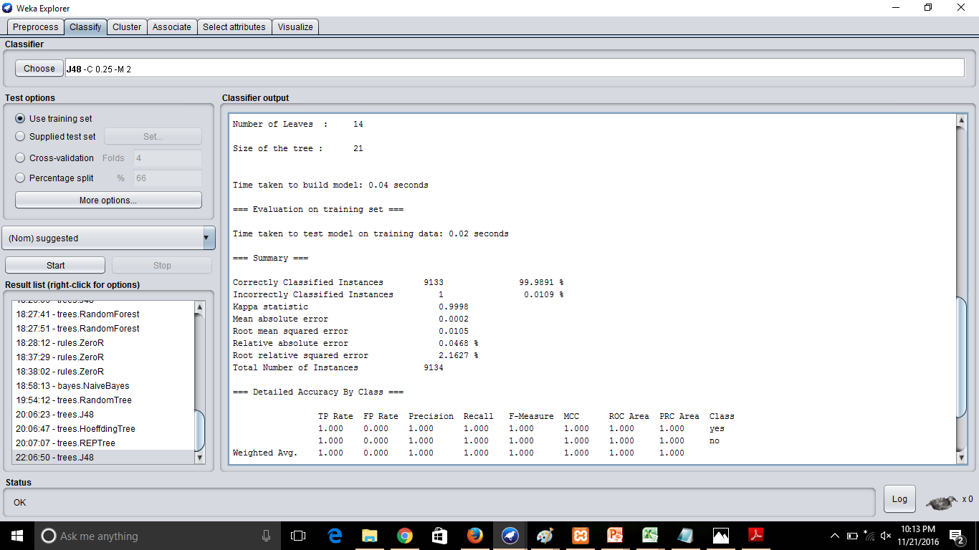

Slide 30
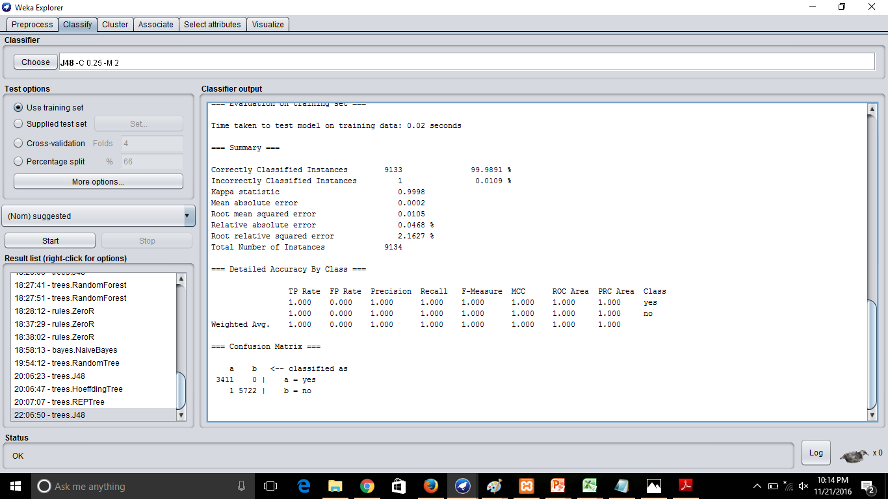

Slide 31
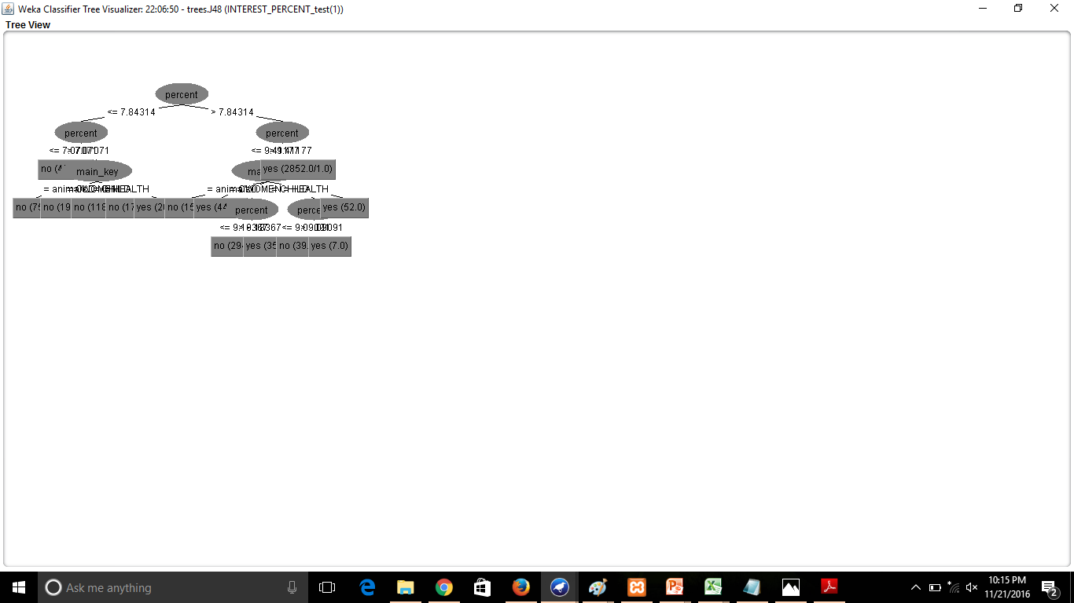
J-48 TREE FOR SUGGESTED=YES/NO

Slide 32
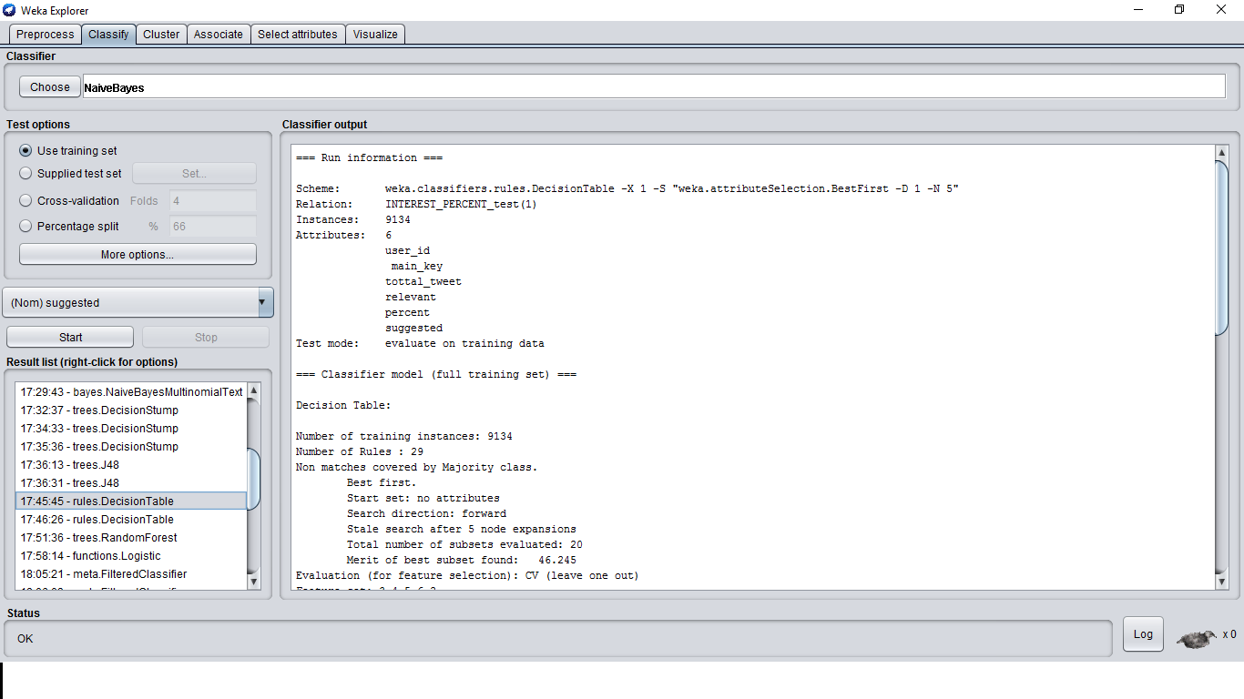
DECISION TABLE

Slide 33
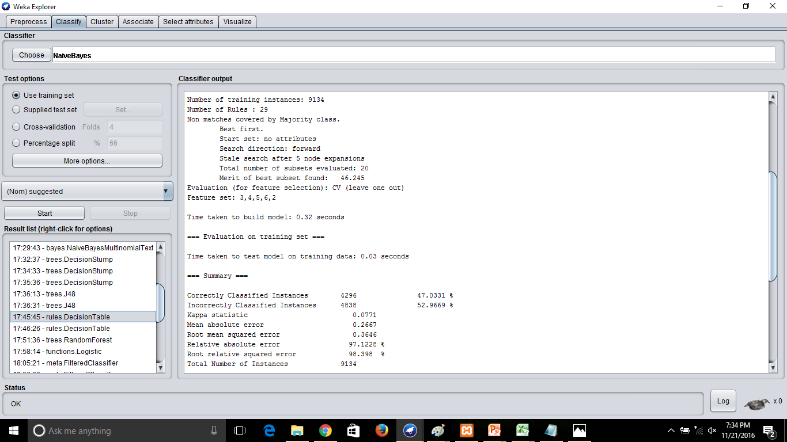

Slide 34
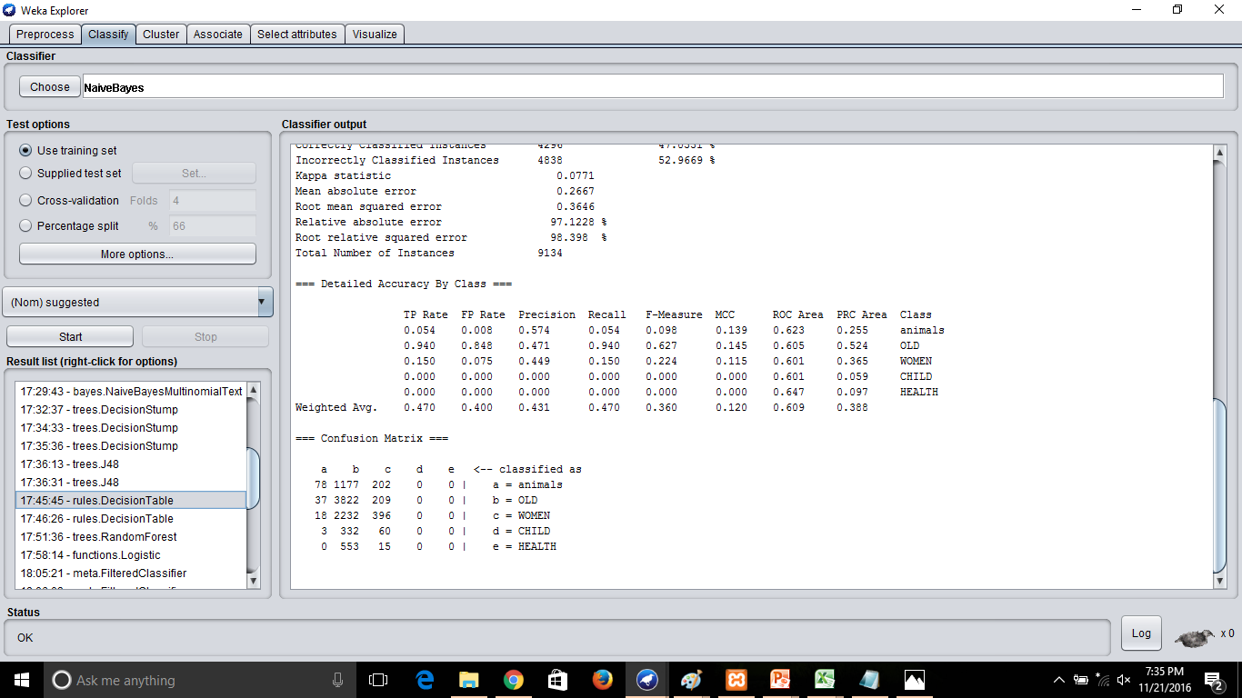

Slide 35
result of decision table
Total Number of instances=9134
Number of rules=29
Correctly Classified Instances=4296
Incorrectly Classified Instances=4838
Mean Absolute Error= 0.2667
Root Mean Squared Error=0.3646

Slide 36
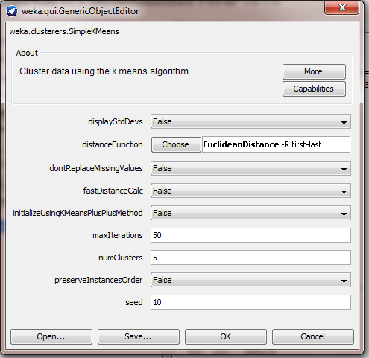
simple K-MEANS

Slide 37
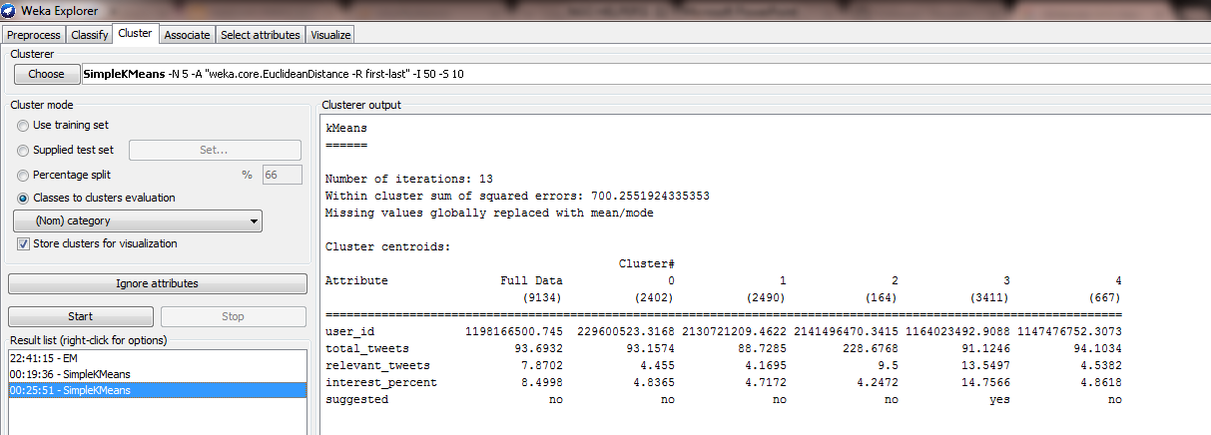

Slide 38
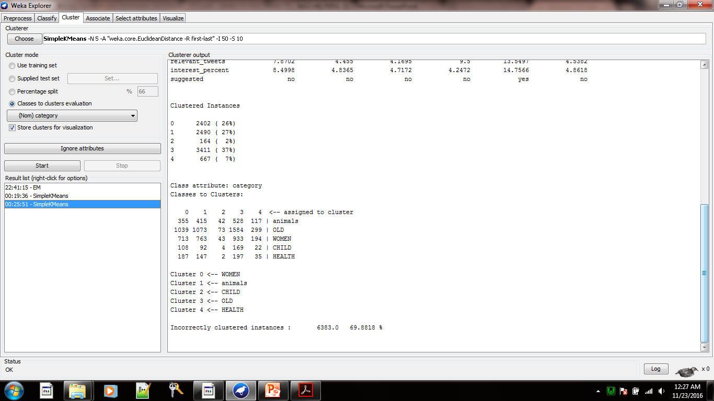

Slide 39
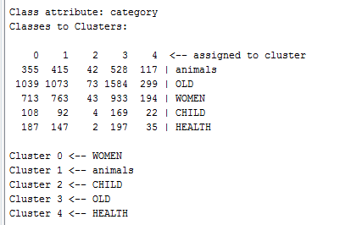
RESULT OF K-MEANS ALGORITHM
Number of iterartions:13
Within cluster sum of squared : 700.2551924335353
Clustered Instances
0 2402 ( 26%)
1 2490 ( 27%)
2 164 ( 2%)
3 3411 ( 37%)
4 667 ( 7%)
Class _ Attribute : main_key
Classes to Clusters:

Slide 40
EVALUATION
Till now we see that logistic classification yields better results due to its less dependence on class conditional independence.
Its performance can further be increased by using ensemble methods like Random forest .
Lets see the implementation of random forest .

Slide 41
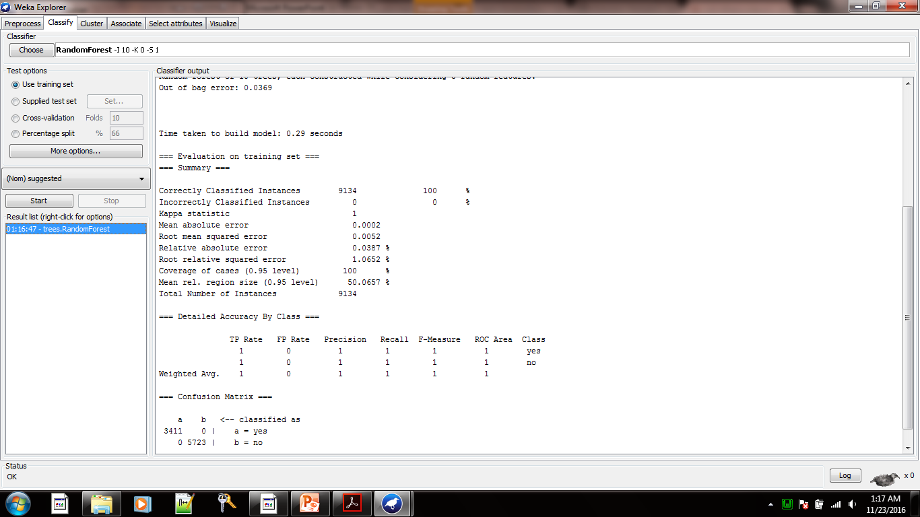
Implementation of random forest

Slide 42
CONCLUSION
Random forest yields best results
Correctly Classified Instances 9134 100 %
Incorrectly Classified Instances 0 0 %
Mean absolute error 0.0002
Root mean squared error 0.0052
Total Number of Instances 9134
=== Detailed Accuracy By Class ===
TP Rate FP Rate Precision Recall F-Measure ROC Area Class
1 0 1 1 1 1 yes
1 0 1 1 1 1 no
Weighted Avg. 1 0 1 1 1 1
=== Confusion Matrix ===
a b <-- classified as
3411 0 | a = yes
0 5723 | b = no

Slide 43
Methodology Cont..
Data Collection
Data Cleaning
Analysis
Results

Slide 44
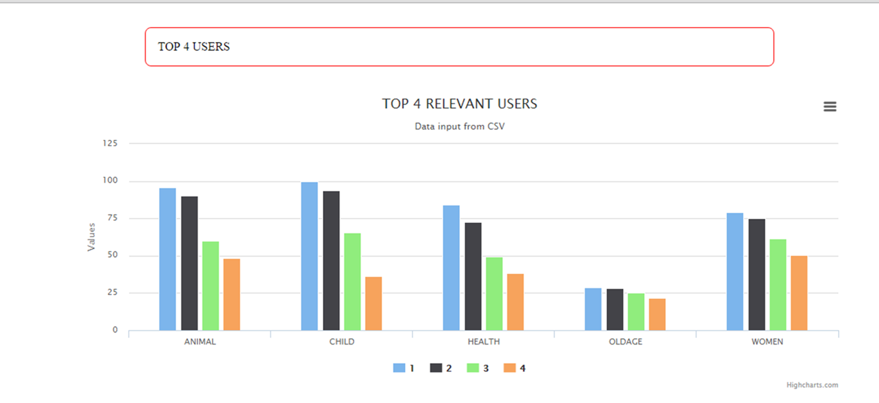
Results: Who Analysis
Top 4 Relevant Users

Slide 45
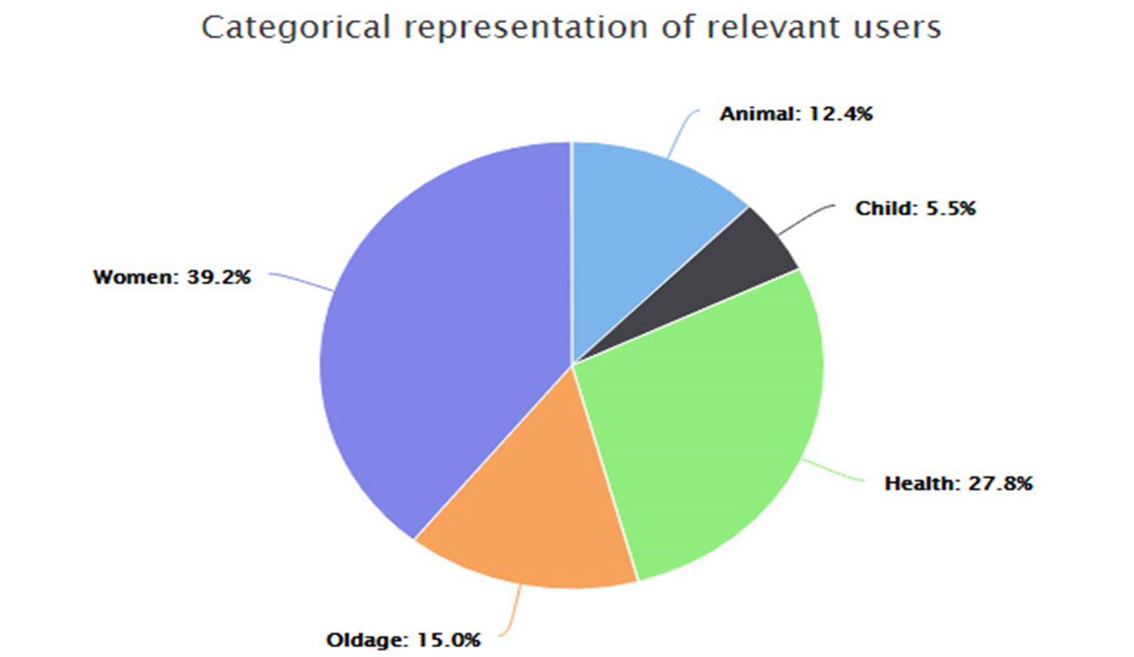
Results: What Analysis
Top 4 Relevant Users

Slide 46
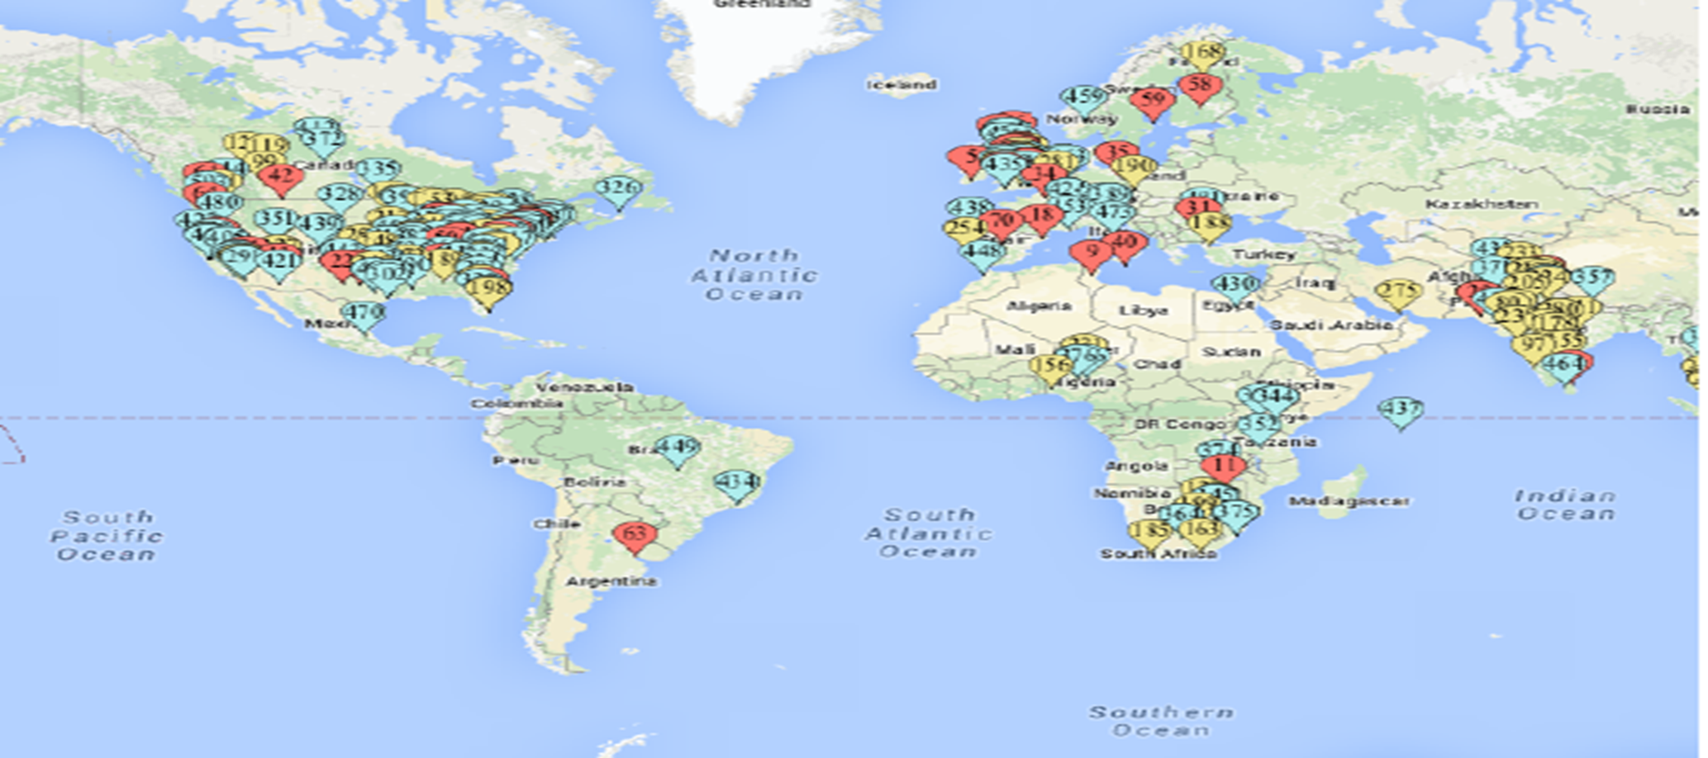
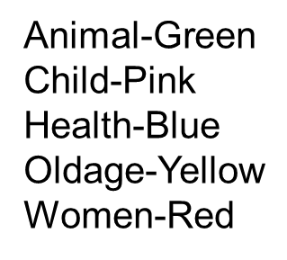
Results: Where Analysis
Fig-5 Figure Showing location of relevant users

Slide 47

Demonstration

Slide 48
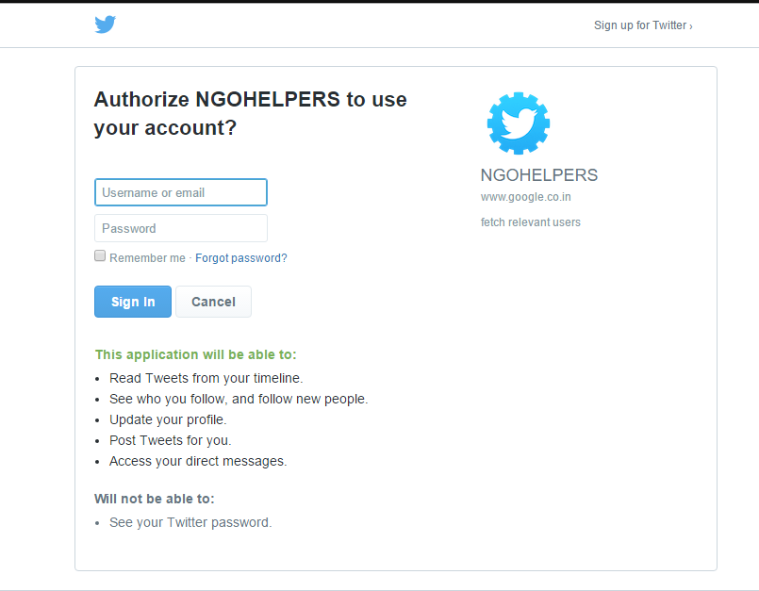
Demonstration: Authorization

Slide 49
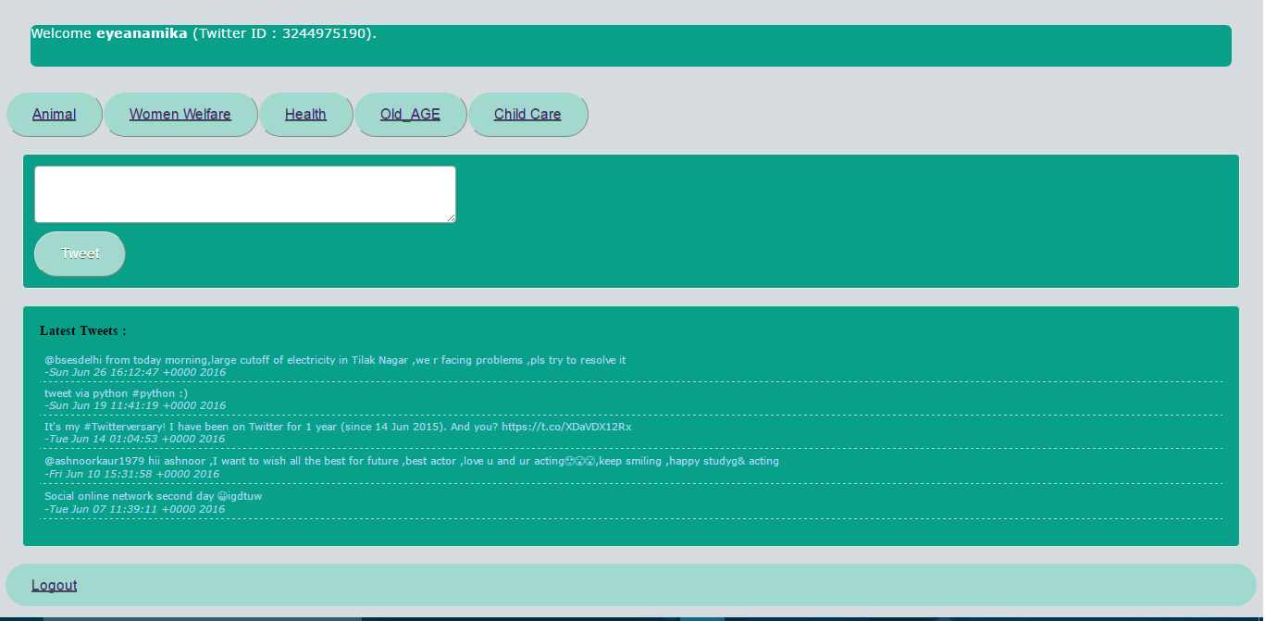
Demonstration: choose Your work domain

Slide 50
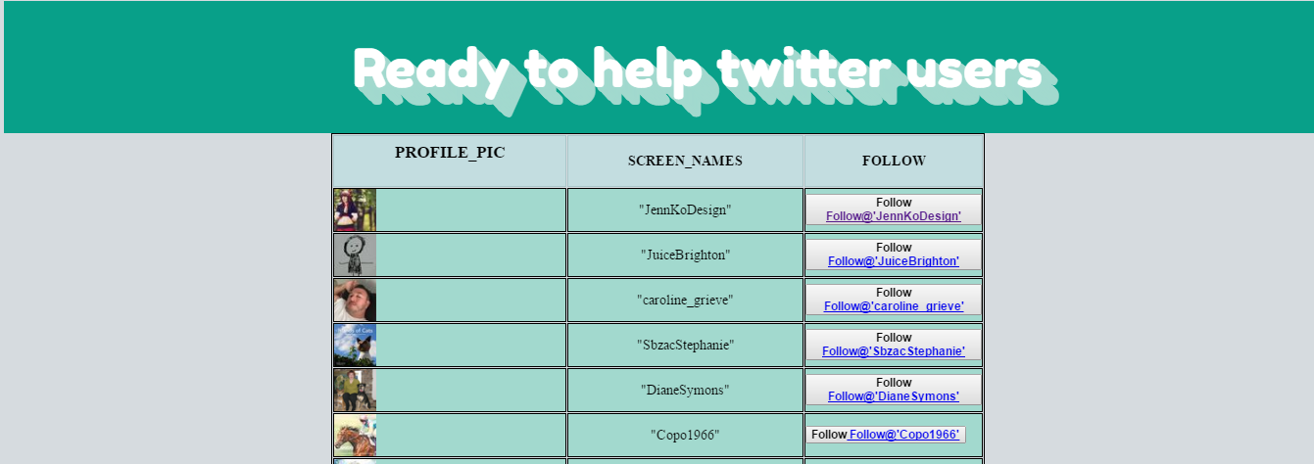
Demonstration: Recommended Users

Slide 51
THANK YOU!!
Nidhi (bhardwaj.sona.sb@gmail.com)
Aishwarya (aishwarya.gupta040495@gmail.com)
Anamika (anamikakatyal.27@gmail.com)

